Slide 1

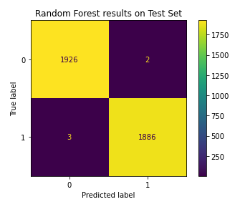
Content Moderation: TikTok's Model for Distinguishing Claims from Opinions
Prepared for: Senior Analyst Team
TikTok's challenge of moderating a vast array of user-generated videos is addressed by implementing a Random Forest Classifier model. This model distinguishes between claims and opinions within videos, a crucial differentiation as claims are more likely to infringe upon the terms of service.
The aim is to automate the initial evaluation phase of the claims process, thus enhancing system efficacy and responsiveness.
Ethically, the model is designed to minimize the risk of undetected terms of service violations.
Key insights from the model’s performance include:
Achieved perfect scores of 1.00 for accuracy, precision, recall, and F1 across test and validation datasets
The confusion matrix results indicated only 2 false positives and 3 false negatives in over 3,800 validation set predictions, aligning with the ethical goal to minimize misclassification of claims
User engagement metrics, notably video views and likes, were the most significant features, suggesting that highly engaged content has a higher propensity to present claims
Despite the high overall performance, the model identified a negligible amount of false negatives, which is critical since these are the primary concern in terms of ethical implications
The feature importance graph revealed that, beyond user engagement, factors like the video's share and download counts also played a significant role in predictions, implying that virality aspects of content might correlate with the presence of claims
Fig 1: Results on unseen data
Considering the model's current performance and future adaptability:
Maintain model monitoring to ensure continued high performance as user behavior and content trends evolve.
Integrate additional features like 'number of times a video was reported' and 'author’s total report count' to further refine the model if necessary.

